Slide 1
Chapter 6
Bottom-Up Parsing

Slide 2
Bottom-up Parsing
A bottom-up parsing corresponds to the construction of a parse tree for an input tokens beginning at the leaves (the bottom) and working up towards the root (the top).
An example follows.

Slide 3
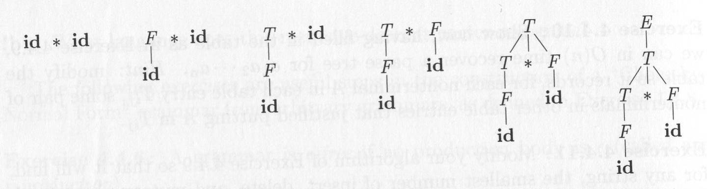
Bottom-up Parsing (Cont.)
Given the grammar:
E → T
T → T * F
T → F
F → id
at this point, a smart parser knows it should not continue to choose E → T to change T to E, but instead, it shift to process id SMARTLY
How can we do that?

Slide 4
Reduction
The bottom-up parsing as the process of “reducing” a token string to the start symbol of the grammar.
At each reduction, the token string matching the RHS of a production is replaced by the LHS non-terminal of that production.

Slide 5
Reduction (Cont.)
The key decisions during bottom-up parsing are about when to reduce and about what production to apply.
Again, just like a top-down parsing, we still have cases that is ambiguous in choosing more than one production rule to reduce

Slide 6
Shift-reduce Parsing
Shift-reduce parsing is a form of bottom-up parsing in which a stack holds grammar symbols and an input buffer holds the rest of the tokens to be parsed.
We use $ to mark the bottom of the stack and also the end of the input.
During a left-to-right scan of the input tokens, the parser shifts zero or more input tokens into the stack, until it is ready to reduce a string β of grammar symbols on top of the stack.

Slide 7
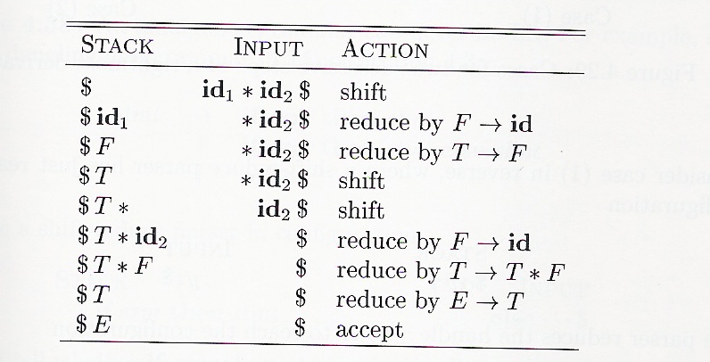
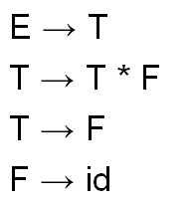
A Shift-reduce Example
OK, here we actually can continue reducing E->T, but it does not, instead it choose a shift smartly. Why? Yes, we need to make it predictive and deterministic

Slide 8
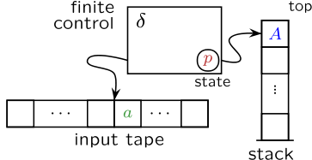
NOTES
As described in CH5, basically this is still a kind of pushdown automata. Remember that CFG and pushdown automata are computationally equivalent

Slide 9
Shift-reduce Parsing (Cont.)
Shift: shift the next input token onto the top of the stack.
Reduce: the right end of the string to be reduced must be at the top of the stack. Locate the left end of the string within the stack and decide what non-terminal to replace that string.
Accept: announce successful completion of parsing.
Error: discover a syntax error and call an error recovery routine.

Slide 10
LR Parsers
Left-scan Rightmost derivation in reverse (LR) parsers are characterized by
the number of look-ahead symbols that are examined to determine parsing actions.
We can make the look-ahead parameter explicit and discuss LR(k) parsers,
where k is the look-ahead size.

Slide 11
LR(k) Parsers
LR(k) parsers are of interest in that they are the most powerful class of deterministic bottom-up parsers using at most K look-ahead tokens.
Deterministic parsers must uniquely determine the correct parsing action at each step;
they cannot back up or retry parsing actions (just like we do not want a back tracking LL parser).
We will cover 4 LR(k) parsers: LR(0), SLR(1), LR(1), and LALR(1) here.

Slide 12
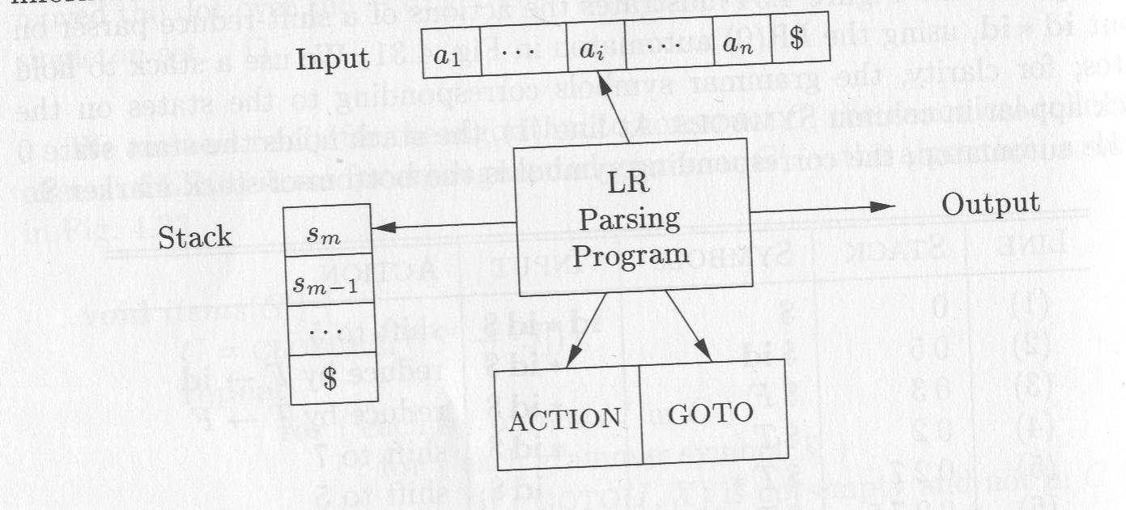
Model of an LR parser
tell the LR parser
to shift token to stack
or reduce a production

Slide 13
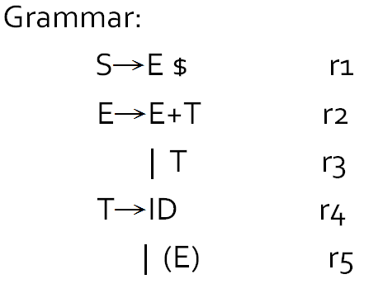
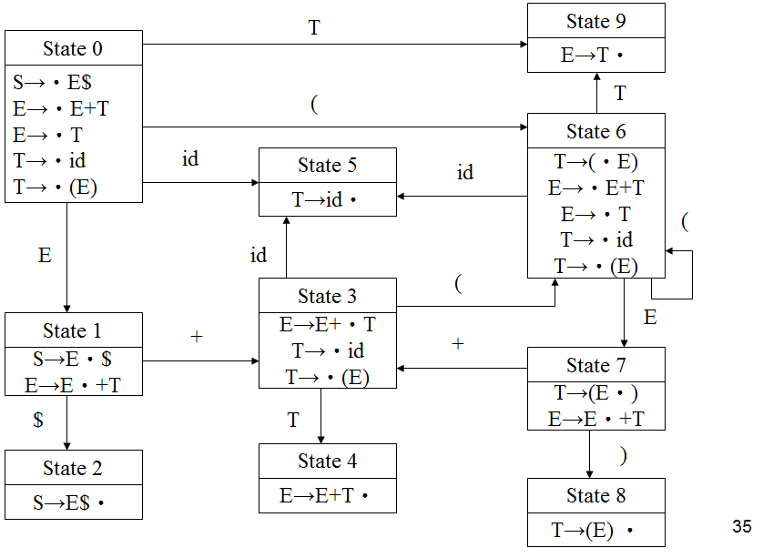
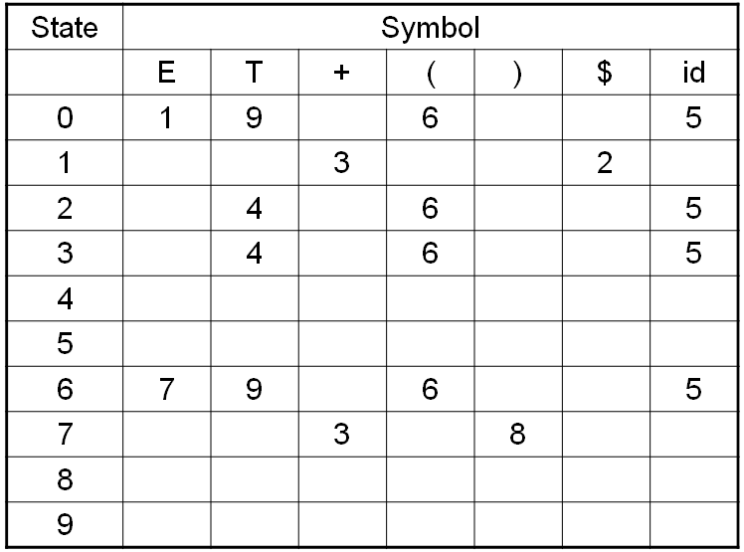
Suppose we can build a following smart state transition table
if stack top is T goto 9
if stack top is ‘(‘ goto 6
reduce E->T
shift
shift
reduce T→ID
shift
shift
shift
reduce E->E+T
reduce T->(E)

Slide 14
Let’s run an example ( ID )
starting from state 0, do shift because state 0 tell you so. So stack = $(
top(stack) = ‘(‘ , so, we go to state 6. state 6 tells you to do shift , so stack = $(ID
top(stack) = ID, so we go to state 5. state 5 tells you to do a reduce T→ID, so stack = $(T
When a reduce occurs, go back to previous shift state 6.
top(stack) = T, so we go to state 9. state 9 tells you to do a reduce E →T , so stack = $(E. Again, go back to state 6
top(stack) = E, so we go to state 7. state 7 tells you to do a shift, so stack = $(E)
top(stack) = ), so we go to state 8. state 8 tells you to do a reduce T → (E), so stack = $T
…..The games go on, until S is reduced….

Slide 15
Question is….
How can we create such a smart transition table to guide the parser choose the right action each time?
Well, like I told you. in 196x, a computer science Ph.D’s topic is to solve the problem.
The ANSWER of course, we need to derive the tranisition table from the grammar. This is all we have.

Slide 16
醜媳婦總是要見公婆 (利用 grammar 來產生 state transition table

Slide 17
LR Parsers (cont.)
In building an LR Parser:
1) Create the Transition Diagram
2) Depending on it, construct:
Go_to Table
Action Table

Slide 18
LR Parsers (cont.)
Go_to table defines the
next state after a shift.
Action table tells parser whether to:
1) shift (S),
2) reduce (R),
3) accept (A) the source code, or
4) signal a syntactic error (E).

Slide 19
Model of an LR parser

Slide 20
LR Parsers (Cont.)
An LR parser makes shift-reduce decisions by maintaining states to keep track of where we are in a parse.
States represent sets of items.

Slide 21
LR(0) Item
LR(0) and all other LR-style parsing are based on the idea of:
an item of the form:
A→X1…Xi‧Xi+1…Xj
The dot symbol ‧, in an item
may appear anywhere
in the right-hand side of a production.
It marks how much of the production
has already been matched. (See the green part)
Remember, this is LR(0) because we do not use any lookahead yet.

Slide 22
LR (0) Item (Cont.)
An LR(0) item (item for short) of a grammar G is a production of G with a dot at some position of the RHS.
The production A → XYZ yields the four items:
A → ‧XYZ
A → X ‧ YZ
A → XY ‧ Z
A → XYZ ‧
The production A → λ generates only one item, A → ‧.

Slide 23
LR(0) Item Closure
If I is a set of items for a grammar G, then CLOSURE(I) is the set of items constructed from I by the 2 rules:
1) Initially, add every item in I to CLOSURE(I)
2) If A → α‧B β is in CLOSURE(I)
and B → γ is a production, then add
B → ‧γ to CLOSURE(I),
if it is not already there.
Apply this until no more new items can be added.

Slide 24
LR(0) Closure Example
E’ → E
E → E + T | T
T → T * F | F
F → (E) | id
I is the set of one item {E’→‧E}.
Find CLOSURE(I)

Slide 25
LR(0) Closure Example (Cont.)
First, E’ → ‧E is put in CLOSURE(I) by rule 1.
Then, E-productions with dots at the left end:
E → ‧E + T and E → ‧T.
Now, there is a T immediately to the right of a dot in
E → ‧T, so we add T → ‧T * F and T → ‧F.
Next, T → ‧F forces us to add:
F → ‧(E) and F → ‧id.

Slide 26
Another Closure Example
S→E $
E→E + T | T
T→ID | (E)
closure (S→‧E$) = {S→‧E$,
E→‧E+T,
E→‧T,
T→‧ID,
T→‧(E)}
The five items above forms an item set
called state s0.
OK, 從前面的說明中，我們知道 transition table 的一個狀態是由這些items 所構成。但是數十年前研究 compiler 的電腦科學家怎麼會想出來這一套技術?

Slide 27
Closure (I)
SetOfItems Closure(I) {
J=I
repeat
for (each item A → α‧B β in J)
for (each production B → γ of G)
if (B → ‧ γ is not in J)
add B → ‧ γ to J;
until no more items are added to J;
return J;
} // end of Closure (I)

Slide 28
Goto Next State
Given an item set (state) s,
we can compute its next state, s’,
under a symbol X,
that is, Go_to (s, X) = s’

Slide 29
Goto Next State (Cont.)
E’ → E
E → E + T | T
T → T * F | F
F → (E) | id
S is the item set (state):
E → E ‧ + T

Slide 30
Goto Next State (Cont.)
S’ is the next state that Goto(S, +) goes to:
E → E +‧T
T → ‧T * F (by closure)
T → ‧F (by closure)
F → ‧(E) (by closure)
F → ‧id (by closure)
We can build all the states of the Transition Diagram this way.

Slide 31
An LR(0) Complete Example
Grammar:
S’→ S $
S→ ID

Slide 32
LR(0) Transition Diagram
State 0
State 1
id
S’ →‧S$
S→‧id
S→id‧
S
State 2
S’ →S‧$
$
State 3
S’ →S$‧

Slide 33
LR(0) Transition Diagram (Cont.)
Each state in the Transition Diagram,
either signals a shift
(‧moves to right of a terminal)
or signals a reduce
(reducing the RHS handle to LHS)

Slide 34
LR(0) Go_to table
State | Symbol
 | ID | $ | S
0 | 1 |  | 2
1
2 |  | 3
3
The blanks above indicate errors.

Slide 35
LR(0) Action table
State | 0 | 1 | 2 | 3
Action | S | R2 | S | A
S for shift
A for accept
R2 for reduce by Rule 2
Each state has only one action.

Slide 36
LR(0) Parsing
Stack Input Action
S0 id $ shift
S0 id S1 $ reduce r2
S0 S S2 $ shift
S0 S S2 $ S3 reduce r1
S0 S’ accept

Slide 37
Another LR(0) Example
Grammar:
S→E $ r1
E→E+T r2
| T r3
T→ID r4
| (E) r5

Slide 38
LR(0) Transition Diagram
T
State 9
State 0
E→T‧
S→‧E$
E→‧E+T
E→‧T
T→‧id
T→‧(E)
(
T
State 6
id
State 5
T→(‧E)
E→‧E+T
E→‧T
T→‧id
T→‧(E)
id
T→id‧
(
E
id
(
State 3
E
State 1
+
E→E+‧T
T→‧id
T→‧(E)
+
S→E‧$
E→E‧+T
State 7
T→(E‧)
E→E‧+T
$
T
State 4
)
State 2
S→E$‧
E→E+T‧
State 8
T→(E) ‧

Slide 39
LR(0) Go_to table
State | Symbol
 | E | T | + | ( | ) | $ | id
0 | 1 | 9 |  | 6 |  |  | 5
1 |  |  | 3 |  |  | 2
2 |  | 4 |  | 6 |  |  | 5
3 |  | 4 |  | 6 |  |  | 5
4
5
6 | 7 | 9 |  | 6 |  |  | 5
7 |  |  | 3 |  | 8
8
9

Slide 40
LR(0) Action table
State: | 0 | 1 | 2 | 3 | 4 | 5 | 6 | 7 | 8 | 9
Action: | S | S | A | S | R2 | R4 | S | S | R5 | R3

Slide 41
LR(0) Parsing
Stack Input Action
S0 id + id $ shift
S0 id S5 + id $ reduce r4
S0 T S9 + id $ reduce r3
S0 E S1 + id $ shift
S0 E S1 + S3 id $ shift
S0 E S1 + S3 id S5 $ reduce r4
S0 E S1 + S3 T S4 $ reduce r2
S0 E S1 $ shift
S0 E S1 $ S2 reduce r1
S0 S accept

Slide 42
NOTES
OK, so far, remember, we simply go to a state, look at the TOP OF STACK, and make a transition. That is why it is LR(0)
We never use the lookahead from the input yet.
If we consider more information from input, we should get a more powerful parser.
What do we mean by powerful parser? The answer is: It creates less shift/reduce and reduce/reduce conflicts why generates transition table. Some conflicts can be automatically resolved if lookahead is considered.

Slide 43
Grammar that is not LR(0)
S → E
E → 1 E
E → 1

Slide 44
Simple LR(1), SLR(1), Parsing
SLR(1) has the same Transition Diagram and Goto table as LR(0)
BUT with different Action table
because it looks ahead 1 token.

Slide 45
SLR(1) Look-ahead
SLR(1) parsers are built first by
constructing Transition Diagram, then by
computing Follow set as SLR(1) look-aheads. Oh yes, we need the follow set again.
The ideas is:
A handle (RHS) should NOT be reduced to N
if the look ahead token is NOT in follow(N)

Slide 46
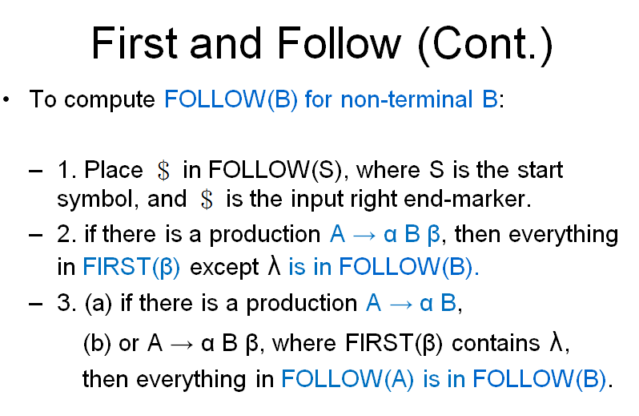
SLR(1) Look-ahead (Cont.)
S→ E $ r1
E→ E + T r2
| T r3
T→ ID r4
T→ ( E ) r5
Follow (S) = { $}
Follow (E) = { ), +, $}
Follow (T) = { ), +, $}
Use the follow sets as look-aheads in reduction.
For your reminder

Slide 47
SLR(1) Transition Diagram
T
State 9
State 0
E→T‧ { ), +, $}
S→‧E$
E→‧E+T
E→‧T
T→‧id
T→‧(E)
(
T
State 6
id
State 5
T→(‧E)
E→‧E+T
E→‧T
T→‧id
T→‧(E)
id
T→id‧ { ), +, $}
E
id
(
(
State 3
E
State 1
+
E→E+‧T
T→‧id
T→‧(E)
+
S→E‧$
E→E‧+T
State 7
T→(E‧)
E→E‧+T
$
T
State 4
)
State 2
S→E$‧{$}
E→E+T‧ { ), +, $}
{
State 8
T→(E) ‧ { ), +, $}

Slide 48
SLR(1) Goto table
 | ID | + | ( | ) | $ | E | T
0 | 5 |  |  |  |  | 1 | 6
1 |  | 3 |  |  | 2
2
3 | 5 |  | 7 |  |  |  | 4
4
5
6
7 | 5 |  | 7 |  |  | 8 | 6
8 |  | 3 |  | 9
9

Slide 49
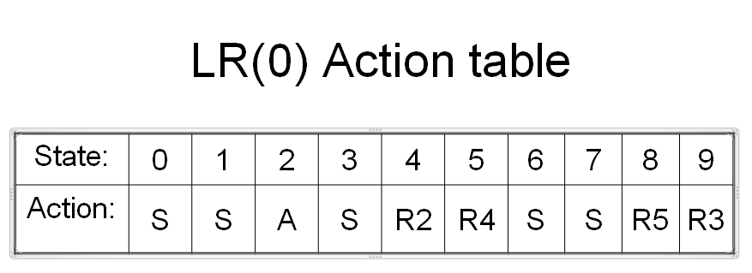
SLR(1) Action table, which expands LR(0) Action table
 | ID | + | ( | ) | $
0 | S |  | S
1 |  | S |  |  | S
2 |  |  |  |  | R1
3 | S |  | S
4 |  | R2 |  | R2 | R2
5 |  | R4 |  | R4 | R4
6 |  | R3 |  | R3 | R3
7 | S |  | S
8 |  | S |  | S
9 |  | R5 |  | R5 | R5
For your comparison
this is LR(0) action table which does concern one lookahead

Slide 50
NOTE
OK, to be honest, the example’s LR(0) have no reduce/reduce conflicts. So, when LR(0) action table is expanded to SLR(1), of course there is no reduce/reduce conflicts neither.
This is no surprise. In other words, the example (from the text books) are not good.

Slide 51
A shift/reduce example from an SLR(1) grammar
The SLR(1) grammar below causes a shift-reduce conflict:
r1,2 S→A | xb
r3,4 A→ aAb | B
r5 B→ x
Use follow(S) = {$},
follow(A) = follow(B) = {b $}
in the SLR(1) Transition Diagram next.

Slide 52
SLR(1) Transition Diagram
State 4
State 7
B
A → B‧ {b$}
B→ x‧ {b$}
B
x
State 0
State 3
S →‧A
S →‧xb
A →‧aAb
A →‧B
B →‧x
A → a‧Ab
A → ‧aAb
A → ‧B
B → ‧x
a
a
A
A
State 1
State 6
S→A‧ {$}
A → aA‧b
b
State 2
S → x‧b
B → x‧ {b$}
State 8
Shift-reduce
conflict
x
A → aAb‧ {b$}
b
State 5
S → xb‧ {$}

Slide 53
SLR(1) Go_to table
 | 0 | 1 | 2 | 3 | 4 | 5 | 6 | 7 | 8
A |  |  |  | 6
B | 4 |  |  | 4
a | 3 |  |  | 3
b |  |  | 5 |  |  |  | 8
x | 2 |  |  | 7

Slide 54
SLR(1) Action table
state token | 0 | 1 | 2 | 3 | 4 | 5 | 6 | 7 | 8
b |  |  | R5/S |  | R4 |  | S | R5 | R3
$ |  | R1 | R5 |  | R4 | R2 |  | R5 | R3
a | S |  |  | S
x | S |  |  | S
State 2 (R5/S) causes shift-reduce conflict:
When handling ‘b’, the parser doesn’t know whether to reduce by rule 5 (R5) or to shift (S).
Solution: Use more powerful LR(1)

Slide 55
LR(1) Parsing
The reason why the FOLLOW set does not work as well as one might wish is that:
It replaces the look-ahead of a single item of a rule N in a given LR state by:
the whole FOLLOW set of N,
which is the union of all the look-aheads of all alternatives of N in all states.
(my quotes: this slide basically tell you SLR(1) is useless in practice)
Solution: Use LR(1)

Slide 56
LR(1) Parsing
LR(1) item sets are more discriminating:
A look-ahead set is kept with each separate item, to be used to resolve conflicts when a reduce item has been reached.
This greatly increases the strength of the parser, but also the size of its tables.

Slide 57
LR(1) item
An LR(1) item is of the form:
A→X1…Xi‧Xi+1…Xj, l
where l belongs to Vt U {λ}
l is look-ahead
Vt is vocabulary of terminals
λ is the look-ahead after end marker $

Slide 58
LR(1) item look-ahead set
Rules for look-ahead sets:
1) initial item set: the look-ahead set of the initial item set S0 contains only one token, the end-of-file token ($), the only token that follows the start symbol.
2) other item set:
Given P → α‧Nβ {σ}, we have
N → ‧γ {FIRST(β{σ}) } in the item set.

Slide 59
LR(1) look-ahead
The LR(1) look-ahead set FIRST(β{σ}) is:
If β can produce λ (β →* λ),
FIRST(β{σ}) is:
FIRST(β) plus the tokens in {σ}, excludes λ.
else
FIRST(β{σ}) just equals FIRST(β);

Slide 60
An LR(1) Example
Given the grammar below,
create the LR(1) Transition Diagram.
r1,2 S→A | xb
r3,4 A→ aAb | B
r5 B→ x

Slide 61
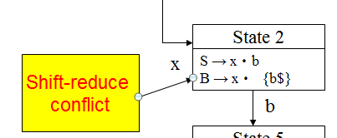
LR(1) Transition Diagram
State 4
State 9
State 7
A → B‧ {b}
B
x
B → x‧ {b}
A → B‧ {$}
B
B
x
State 0
State 3
State 10
S →‧A {$}
S →‧xb {$}
A →‧aAb {$}
A →‧B {$}
B →‧x {$}
A → a‧Ab {$}
A → ‧aAb {b}
A → ‧B {b}
B → ‧x {b}
A → a‧Ab {b}
A → ‧aAb {b}
A → ‧B {b}
B → ‧x {b}
a
a
a
A
A
A
State 1
State 6
State 11
S→A‧ {$}
A → aA‧b {$}
A → aA‧b {b}
b
b
State 2
S → x‧b {$}
B → x‧ {$}
State 8
State 12
x
A → aAb‧ {$}
A → aAb‧ {b}
b
old SLR(1)
OK, now b is not included in the follow set
State 5
S → xb‧ {$}

Slide 62
LR(1) Go_to table
 | 0 | 1 | 2 | 3 | 4 | 5 | 6 | 7 | 8 | 9 | 10 | 11 | 12
A | 1 |  |  | 6 |  |  |  |  |  |  | 11
B | 4 |  |  | 9 |  |  |  |  |  |  | 9
a | 3 |  |  | 10 |  |  |  |  |  |  | 10
b |  |  | 5 |  |  |  | 8 |  |  |  |  | 12
x | 2 |  |  | 7 |  |  |  |  |  |  | 7

Slide 63
LR(1) Action table
State token | 0 | 1 | 2 | 3 | 4 | 5 | 6 | 7 | 8 | 9 | 10 | 11 | 12
$ |  | R1 | R5 |  | R4 | R2 |  |  | R3
b |  |  | S |  |  |  | S | R5 |  | R4 |  | S | R3
a | S |  |  | S |  |  |  |  |  |  | S
x | S |  |  | S |  |  |  |  |  |  | S
The states are from 0 to 12 and
the terminal symbols include $,b,a,x.

Slide 64
LR(1) Parsing
LR(1)’s problem is that:
The LR(1) Transition Diagram
contains so many states that
the Go_to and Action tables
become prohibitively large.
Solution: Use LALR(1) (look-ahead LR(1) ) to reduce table sizes.

Slide 65
NOTES
YES, it is weird. We improve SLR(1) into LR(1), which is powerful, however, resource intensive.
Imaging when you compiler a program, the compiler need 1G of memory to proceed. This is not good.

Slide 66
Look-ahead LR(1), LALR(1), Parsing
LALR(1) parser can be built by
first constructing an LR(1) transition diagram and then merging states.
It differs with LR(1) only in its
merging look-ahead components of
the items with common core.

Slide 67
LALR(1) Parsing (Cont.)
Consider states s and s’ below in LR(1):
s : A→a‧ {b} s’ : A→a‧ {c}
B→a‧ {d} B→a‧{e}
s and s’ have common core :
A→a‧
B→a‧
So, we can merge the two states :
A→a‧ {b,c}
B→a‧ {d,e}

Slide 68
LALR(1) Parsing (Cont.)
For the grammar:
r1,2 S→A | xb
r3,4 A→ aAb | B
r5 B→ x
Merge the states in the LR(1) Transition Diagram to get that of LALR(1).

Slide 69
LALR(1) Transition Diagram
State 4,9
B
x
State 7
A → B‧ {b$}
B → x‧ {b}
B
State 0
State 3,10
S →‧A {$}
S →‧xb {$}
A →‧aAb {$}
A →‧B {$}
B →‧x {$}
A → a‧Ab {b$}
A → ‧aAb {b}
A → ‧B {b}
B → ‧x {b}
a
a
A
A
State 1
State 6,11
S→A‧ {$}
A → aA‧b {b$}
b
State 2
S → x‧b {$}
B → x‧ {$}
State 8,12
x
A → aAb‧ {b$}
b
State 5
S → xb‧ {$}

Slide 70
Merging States
LALR(1) State | LR(1) States with Common Core
State 0 | State 0
State 1 | State 1
State 2 | State 2
State 3 | State 3, State 10
State 4 | State 4, State 9
State 5 | State 5
State 6 | State 6, State 11
State 7 | State 7
State 8 | State 8, State 12

Slide 71
LALR(1) Go_to table
 | 0 | 1 | 2 | 3 | 4 | 5 | 6 | 7 | 8
A | 1 |  |  | 6
B | 4 |  |  | 4
a | 3 |  |  | 3
b |  |  | 5 |  |  |  | 8
x | 2 |  |  | 7

Slide 72
LALR(1) Action table
 | 0 | 1 | 2 | 3 | 4 | 5 | 6 | 7 | 8
$ |  | R1 | R5 |  | R4 | R2 |  |  | R3
b |  |  | S |  | R4 |  | S | R5 | R3
a | S |  |  | S
x | S |  |  | S

Slide 73
An Example of 4 LR Parsings
Given the grammar below:
r1 E → T Op T
r2 T → a
r3 | b
r4 Op → +
write 1) state transition diagram
2) action table
3) goto table
for 1) LR(0), 2) SLR(1), 3) LR(1) and 4) LALR(1)
4 bottom-up parsing methods, respectively.

Slide 74
LR(0) transition diagram
State 0
State 1
State 4
E → ‧T Op T
T → ‧a
T → ‧b
T
E → T‧Op T
Op → ‧+
Op
E → T Op‧T
T → ‧a
T → ‧b
+
a
b
State 5
Op → +‧
T
b
State 2
State 3
T → a‧
T → b‧
State 6
E → T Op T‧
a

Slide 75
LR(0) Action table
State | 0 | 1 | 2 | 3 | 4 | 5 | 6
Action | S | S | R2 | R3 | S | R4 | A

Slide 76
LR(0) Go_to table
 | E | T | Op | a | b | +
0 |  | 1 |  | 2 | 3
1 |  |  | 4 |  |  | 5
2
3
4 |  | 6 |  | 2 | 3
5
6

Slide 77
SLR(1) Transition Diagram
Simply add Follow(N) as look-ahead to the state
that is about to do N reduction.
State 0
State 1
State 4
E → ‧T Op T
T → ‧a
T → ‧b
T
E → T‧Op T
Op → ‧+
Op
E → T Op‧T
T → ‧a
T → ‧b
+
a
b
State 5
Op → +‧{a b}
T
b
State 2
State 3
T → a‧{+ $}
T → b‧{+ $}
State 6
E → T Op T‧{$}
a

Slide 78
SLR(1) Action table
State | 0 | 1 | 2 | 3 | 4 | 5 | 6
a | S |  |  |  | S | R4
b | S |  |  |  | S | R4
+ |  | S | R2 | R3
$ |  |  | R2 | R3 |  |  | A

Slide 79
SLR(1) Go_to table
The SLR(1) goto table is the same as
that of LR(0).

Slide 80
LR(1) Transition Diagram
Add look-ahead sets when about to reduce.
State 0
State 1
State 4
E → ‧T Op T {$}
T → ‧a {+}
T → ‧b {+}
T
E → T‧Op T {$}
Op → ‧+ {a b}
Op
E → T Op‧T {$}
T → ‧a {$}
T → ‧b {$}
+
State 5
a
b
Op → +‧{a b}
T
State 2
State 3
b
T → a‧{+}
T → b‧{+}
a
State 6
State 7
State 8
E → T Op T‧{$}
T → a‧{$}
T → b‧{$}

Slide 81
LR(1) Action table
State | 0 | 1 | 2 | 3 | 4 | 5 | 6 | 7 | 8
a | S |  |  |  | S | R4
b | S |  |  |  | S | R4
+ |  | S | R2 | R3
$ |  |  |  |  |  |  | A | R2 | R3

Slide 82
LR(1) Go_to table
 | E | T | Op | a | b | +
0 |  | 1 |  | 2 | 3
1 |  |  | 4 |  |  | 5
2
3
4 |  | 6 |  | 7 | 8
5
6
7
8

Slide 83
LALR(1) Transition diagram
Merge states with common core:
State 0
State 1
State 4
E → ‧T Op T {$}
T → ‧a {+}
T → ‧b {+}
T
E → T‧Op T {$}
Op → ‧+ {a b}
Op
E → T Op‧T {$}
T → ‧a {$}
T → ‧b {$}
+
State 5
a
b
Op → +‧{a b}
T
b
State 2, 7
State 3, 8
T → a‧{+ $}
T → b‧{+ $}
State 6
E → T Op T‧{$}
a

Slide 84
LALR(1) Action table
State | 0 | 1 | 4 | 5 | 6 | 2, 7 | 3, 8
a | S |  | S | R4
b | S |  | S | R4
+ |  | S |  |  |  | R2 | R3
$ |  |  |  |  | A | R2 | R3

Slide 85
LALR(1) Go_to table
 | E | T | Op | a | b | +
0 |  | 1 |  | 2, 7 | 3, 8
1 |  |  | 4 |  |  | 5
4 |  | 6 |  | 2, 7 | 3, 8
5
6
2, 7
3, 8
Think: when parsing a $ b,
LALR(1) will be less powerful than LR(1).

Slide 86
Final Notes
OK, finally, you know what Bison/YACC is doing.
You give it a LALR(1) grammar, it parses your grammar and then generate goto_table, action table (with lookahead), and the code to execute the pushdown automata. These elements form a parser.
When you input a stream of tokens, the parser read input and execute the pushdown automata smartly, efficiently, with the tables.

Slide 87
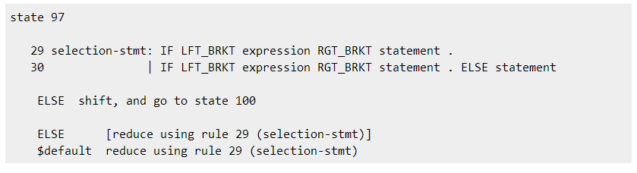
How to resolve conflicts
OK, sometimes your grammar generates shift/reduce or reduce/reduce conflicts. How can we do about it?
The answer: rewrite the grammar so that it still can do the same thing but the conflicts can be resolved.

Slide 88
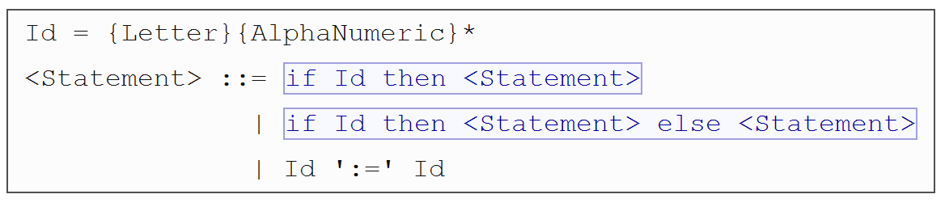
Example – The Hanging-Else problem
A shift/reduce error

Slide 89
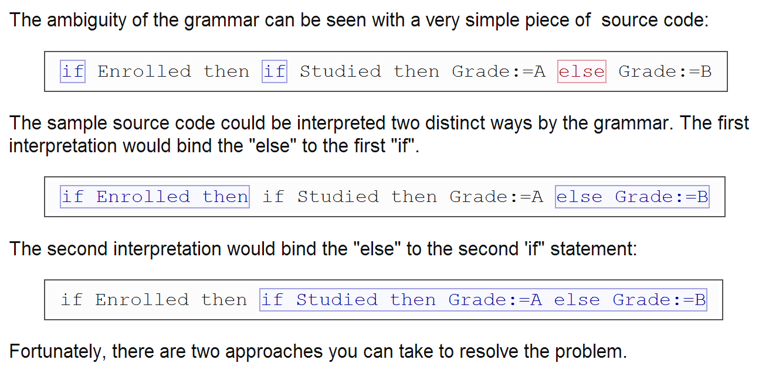
Causes

Slide 90
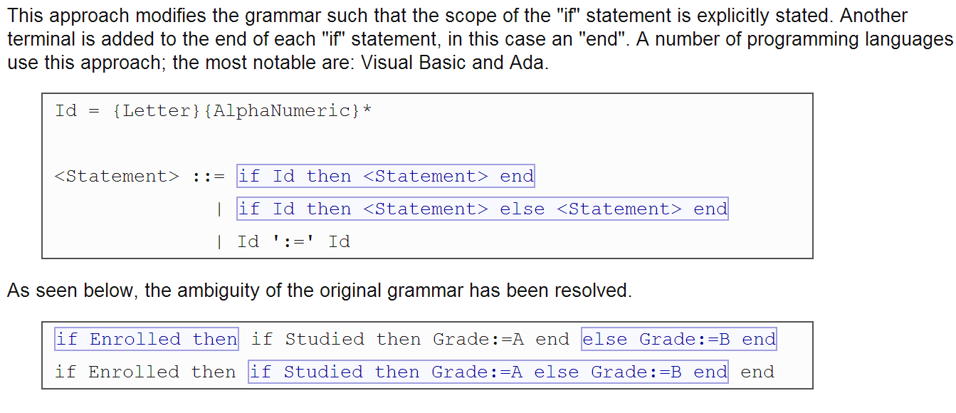
Solution #1

Slide 91
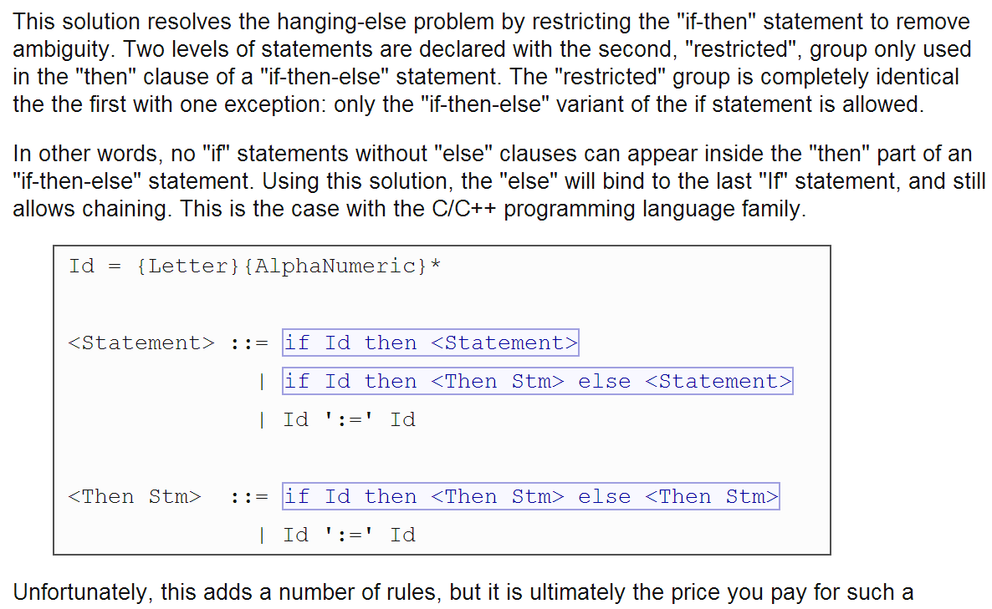
Solution #2

Slide 93
Homework
Construct the Transition Diagram, Action table and Go_to table for:
LR(0), SLR(1), LR(1), and LALR(1) respectively for the grammar below:
S → xSx
| x

Slide 94
Homework Answer LR(0) Transition Diagram
State 0
State 1
S → ‧xSx
S → ‧x
S → x‧Sx
S → x‧
S → ‧xSx
S → ‧x
State 2
x
S
S → xS ‧ x
x
x
State 3
S → xSx‧

Slide 95
LR(0) Action/Go_to tables
State | 0 | 1 | 2 | 3
Action | S | S/R | S | A
Action table
Go_to table
 | x | S
0 | 1
1 | 1 | 2
2 | 3
3

Slide 96
LR(1) Transition Diagram
State 0
State 1
S → ‧xSx {$}
S → ‧x {$}
S → x‧Sx {$}
S → x‧ {$}
S → ‧xSx {x}
S → ‧x {x}
State 2
x
S
S → xS‧x {$}
x
x
State 4
State 3
S →x ‧Sx {x}
S → x‧ {x}
S → ‧ xSx {x}
S → ‧ x {x}
S → xSx‧ ($}
x
S
State 5
State 6
x
S → xS‧x (x}
S → xSx‧ (x}

Slide 97
LR(1) Action, Go_to tables
Action table
Go_to table
 | x | $
0 | S
1 | S | R2
2 | S
3 |  | R1
4 | S/R2
5 | S
6 | R1
 | x | S
0 | 1
1 | 4 | 2
2 | 3
3
4 |  | 5
5 | 6
6

Slide 98
SLR(1) Transition Diagram
State 0
State 1
S → ‧xSx {$}
S → ‧x {$}
x
S → x‧Sx {x$}
S → x‧ {x$}
S → ‧xSx {x}
S → ‧x {x}
x
S
State 2
S →x S‧x {x$}
x
State 3
S → xSx‧ (x$}

Slide 99
SLR(1) Action, Go_to tables
Action table
Go_to table
 | x | $
0 | S
1 | S/R2 | R2
2 | S
3 | R1 | R1
 | x | S
0 | 1
1 | 1 | 2
2 | 3
3

Slide 100
LALR(1) Transition Diagram
State 0
State 1
S → ‧xSx {$}
S → ‧x {$}
x
S → x‧Sx {x$}
S → x‧ {x$}
S → ‧xSx {x}
S → ‧x {x}
x
S
State 2
S →x S‧x {x$}
x
State 3
S → xSx‧ (x$}

Slide 101
LALR(1) Action, Goto tables
The LALR (1) action table and go_to table are the same as those in SLR(1).

